Slide 1
State Management with Flux
Michiel Doeven @ Techorama 2022
Notes:
Welcome everyone
Competence Lead for ShareValue

Slide 2

Notes:
ShareValue has been around for 11 years now and because of Covid our 10-year anniversary was celebrated couple of weeks ago.
As you can see, we went to Valencia.
Later on, I will have some other things I want to share.
But let’s start.

Slide 3
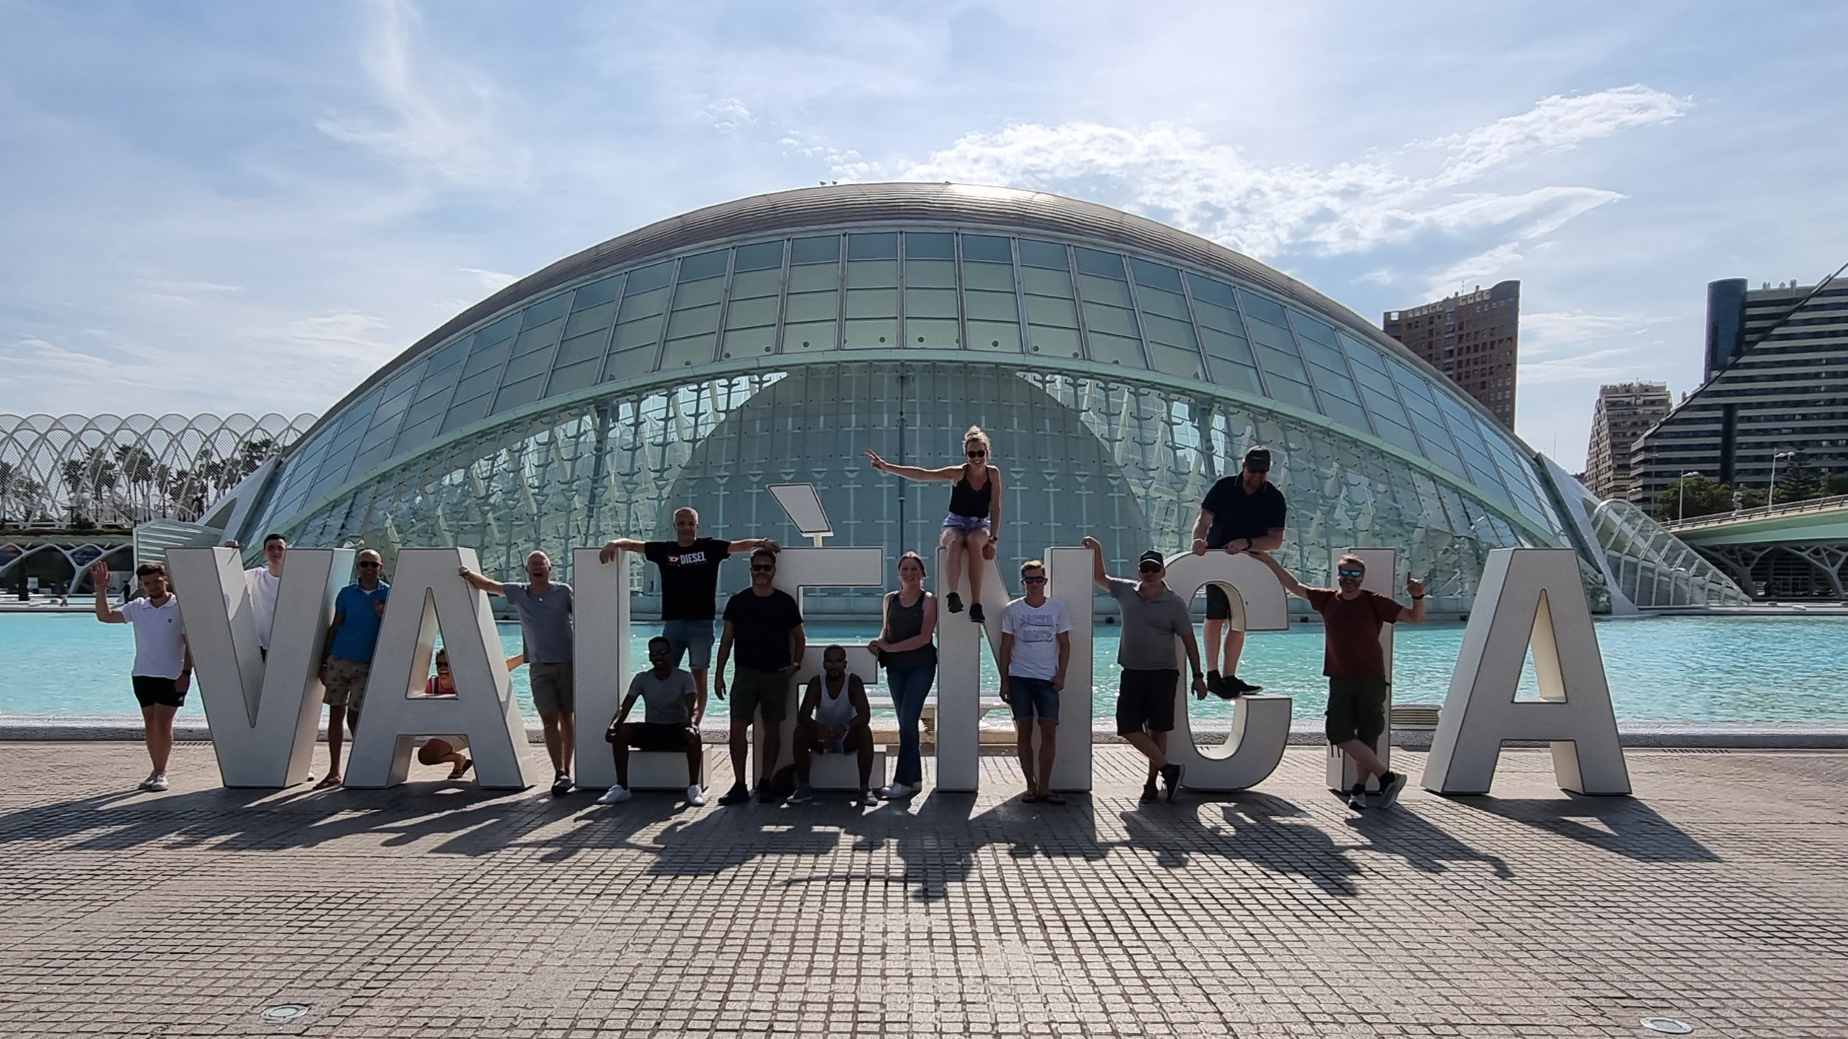
Notes:
ShareValue has been around for 11 years now and because of Covid our 10-year anniversary was celebrated couple of weeks ago.
As you can see, we went to Valencia.
Later on, I will have some other things I want to share.
But let’s start.

Slide 4

Notes:
ShareValue has been around for 11 years now and because of Covid our 10-year anniversary was celebrated couple of weeks ago.
As you can see, we went to Valencia.
Later on, I will have some other things I want to share.
But let’s start.

Slide 5
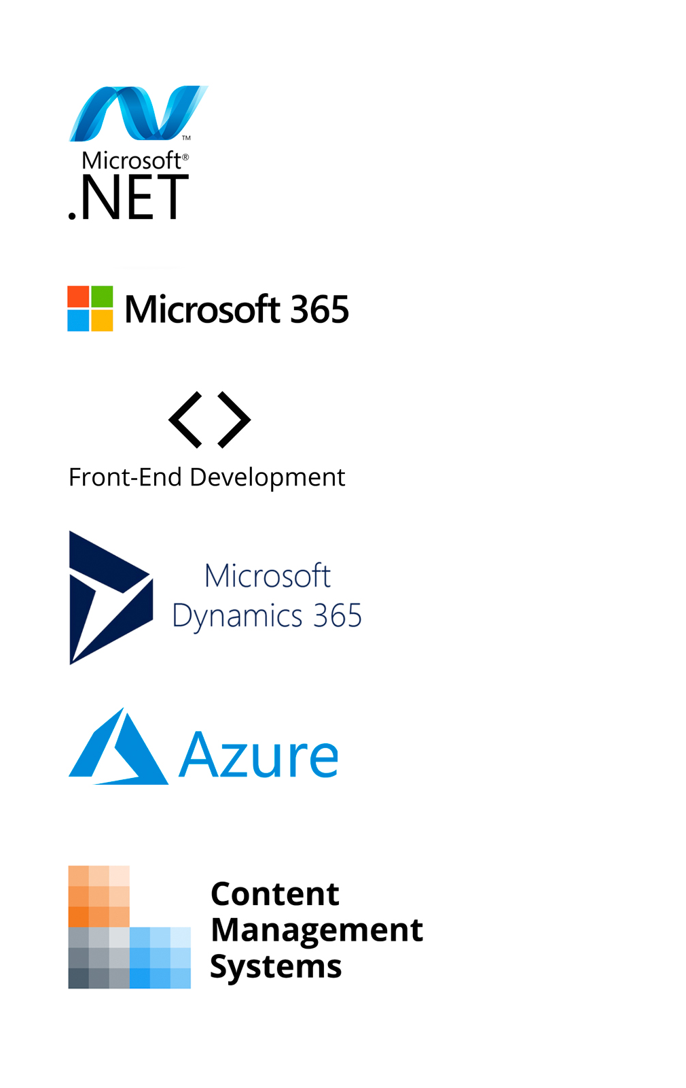
Agenda
Terminology
Flux pattern
Fluxor
Demo
Notes:
Terminology: what’s what.

Slide 6





Terminology
NGRX
RxJS
Notes:
1. Flux = pattern sort of observer pattern
2. Redux = JavaScript library that implements Flux pattern for react
3. NgRx Store provides reactive state management for Angular apps inspired by Redux.
NgRx relies on RxJS Observables to listen for store events, select those that matter, and push the selected object(s) to your application

Slide 7
Subject maintains list of Observer and notifies when subject changes.
Observer pattern
Subject
Observer can register/unregister on Subject.
View is updated based on notifications received by Observer.
Notify
Observer
View

Slide 8
User does something that sends (or Dispatches) an Action.
Action
Reducer reacts to different Actions and updates the State.
View listens for when State has changed
Dispatch
Store
View

Slide 9
Action
Dispatcher
Store
Reducer
Feature
State
User interface
“Hello Techorama”

Slide 10
Action
Action
Dispatcher
Store
Reducer
Effect
Data
State
User interface
isLoading = true
data: []
isLoading = false
data: [objects]

Slide 11

Demo
Fluxor
Multiple Components
Redux DevTools
localStorage with Blazorized

Slide 12
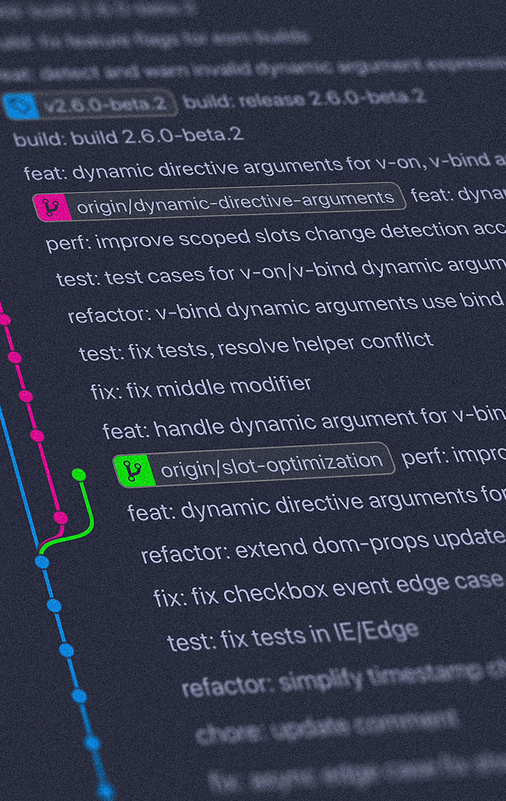

Demo
github.com/ShareValueNL
Techorama-2022-Demo
© Yancy Min (Unsplash)
Notes:
Photo by Yancy Min on Unsplash

Slide 13


